Slide 1
Software Engineering and Architecture
Networking 101

Slide 2
Motivation
Networking - not a curriculum issue in SWEA…
… it is next semester in another course
But…
You see it everywhere
And you need some ‘Network for dummies’ for our Broker…

Slide 3
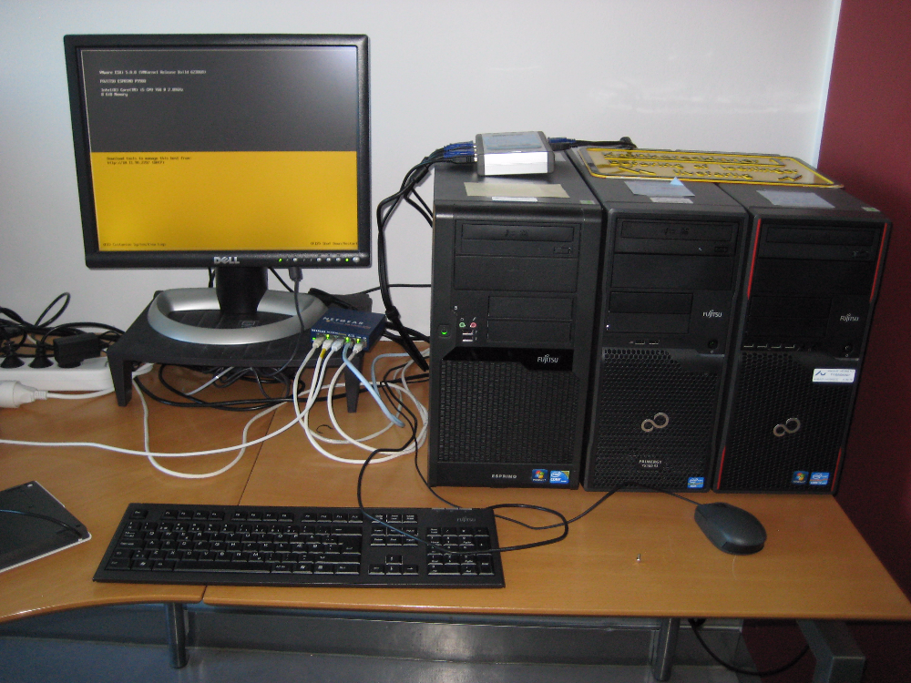
A Network
… in CS is basically two or more machines connected by electrical wires that allows to send signals between the machines…

Slide 4
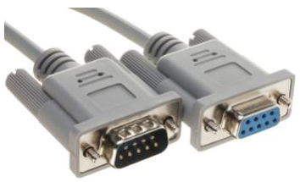
A Network
My first exposure: RS232 on Z80 CPUs
Today’s web: TCP/IP over Ethernet

Slide 5
TCP/IP
Transmission Control Protocol and Internet Protocol
By the US Department of Defence (DARPA)
Key Idea
Segment transmission into Packets (”Datagrams”)
Layered architecture, each with specific responsibilities (roles!)

Slide 6
TCP/IP
By Jsoon eu (talk) - I (Jsoon eu (talk)) created this work entirely by myself., CC BY-SA 3.0, https://en.wikipedia.org/w/index.php?curid=29962617

Slide 7
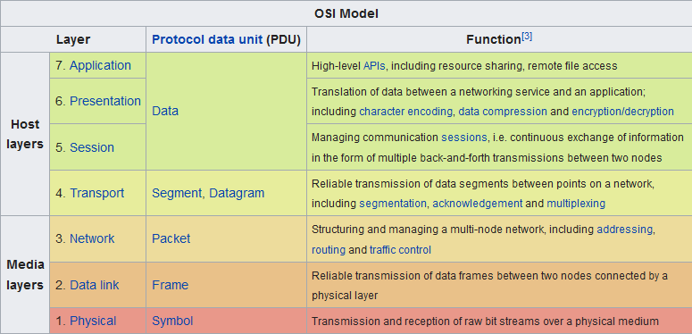
OSI Model
Another but similar model

Slide 8
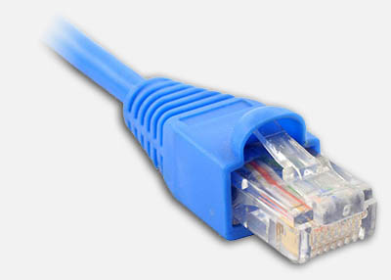
TCP/IP Layers
Transport layer
TCP Reliable, ordered, error-checked data delivery
Transmission Control Protocol
Network / Internet Layer
IP Relaying datagrams across networks
Internet protocol
Physical + Data Link Layer
802.3 Ethernet Hardware and cables
802.11 WiFi Cables gone

Slide 9
Internet Protocol
IP: Send datagram

Slide 10
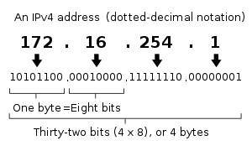
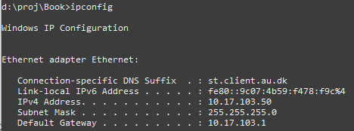
IPv4
Defines the terminology that we use and it pops up even at the software level
Every computer on the network has an address
Type ‘ifconfig’/’ipconfig’ to find yours
Some ranges are reserved
10.*.*.*, 172.16.*.*., 192.168.*.* are private networks
127.0.0.1 is localhost = myself
Notes:
Only 4.3 Bill network addresses possible, less than # of people on earth!

Slide 11
IP and Ports
So given an IP (like 91.221.196.224) you uniquely identify a computer
The OS of that computer expose 64K ports
Also predefined port numbers
7: echo (‘ping’)
20: ftp
22: ssh
80: HTTP
443: HTTPS
Thus
91.221.196.224:80 is the HTTP port of a specific computer
If port 80 is active it is probably a web server
Think: port = dueslag/“postkasse”

Slide 12
Ports
On Linux, all ports below 1024 are reserved for ‘root’
Only superuser (administrator) can use these…
Above that, it is ‘free game’ to assign/use a port, but you may interfere with other programs that have picked one...

Slide 13
Datagram
So, for node A and node B to communicate some data
Say, a request for a web page, and the server reply
A creates a request
N datagrams (the data segmented into packet size)
Each datagram contains
Part # i (”packet i”) of the full data
Destination IP address Who is to receive?
Source IP address Who should have the reply?
B creates a reply
Of course the same ☺

Slide 14
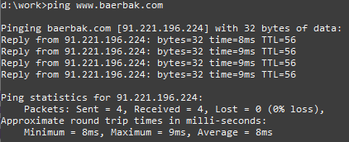
Ping
Port 7 is reserved for ‘ping’
A classic availability pattern: ‘ping/echo’
Verify that a given machine is currently turned on
I have a computer running ‘www.baerbak.com’
Will send datagram on port 7 and print round trip time

Slide 15
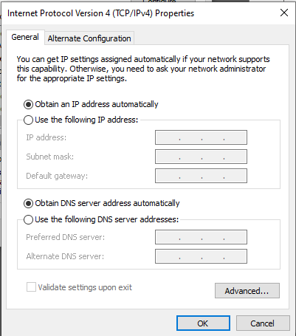
Uhum?
So how did your machine get that IP address?
Either static IP (never used except…)
You assign an IP directly on the machine!
(and hope no other on the network has the same address!)
Or dynamic IP
DHCP – dynamic host configuration protocol
Broadcast a “help – I need an address”
DHCP server will assign one and give it
Usually your router at home
At CS it is a dedicated server machine

Slide 16
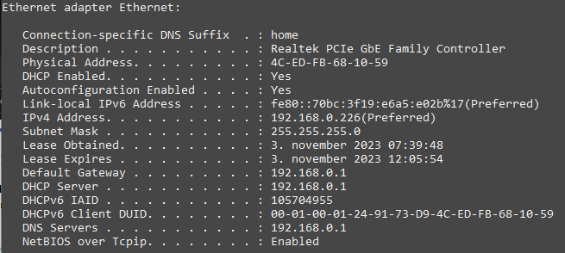
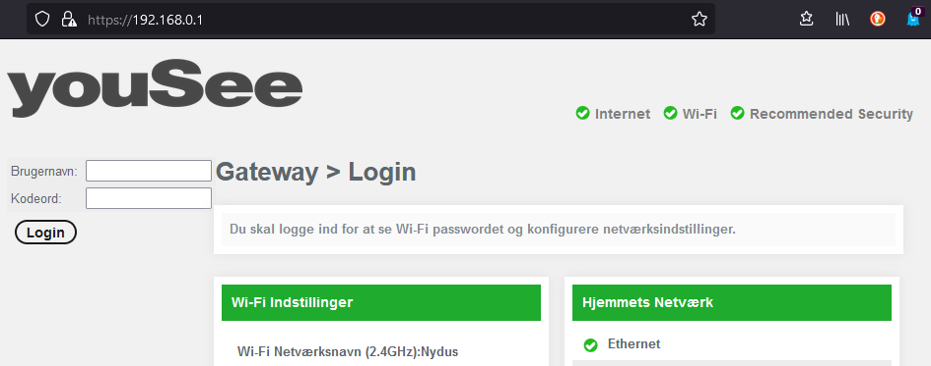
DHCP
On my Windows machine
ipconfig /all
Which is the IP of my router…

Slide 17
Domain Name System
IP addresses are a bit hard to remember, right?

Slide 18
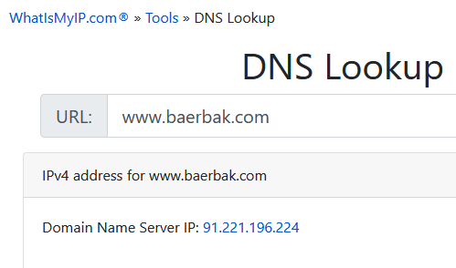
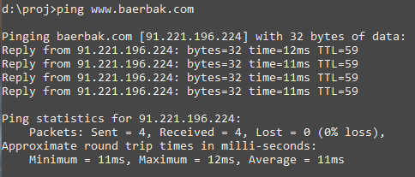
DNS
Who can remember 87.238.248.136 ???
DNS (Domain Name System) are Name Services
Computers that translate names into IP addresses

Slide 19
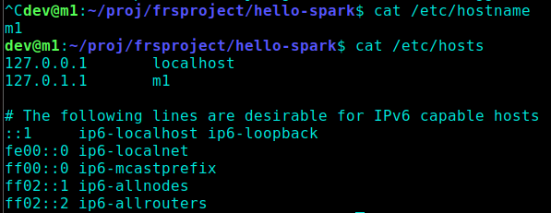
Local names
Any computer has its own name
Normally you give it a name when installing
On Linux you may change it by editing a few files
Localhost is 127.0.0.1 which is the IP address of the computer itself! The name of it is ‘localhost’

Slide 20
Your Own DNS
You can actually maintain your own DNS by editing the hosts file on Linux
Do not ☺ - it only works on my machine!

Slide 21
Local DNS
At my home I have a WiFi Router, supplied by my internet provider. It create a local network with local names
Of course, only computers on this network can access each other by their names
Not visible on the ‘full internet’

Slide 22
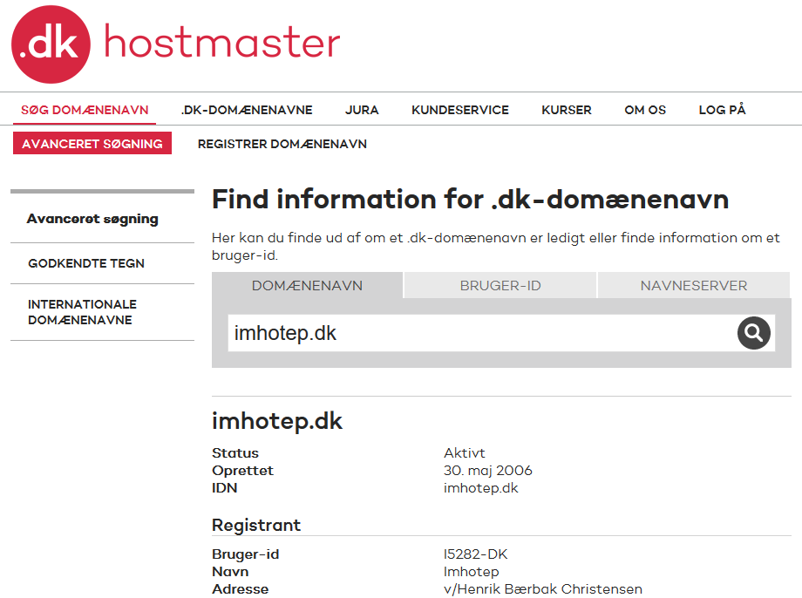
Global DNS
But what if I want to expose a node on the full internet?
So – how do I get a global domain name?
For ‘.dk’ domains DK-Hostmaster keeps track of all Danish domains
It costs money
~50 Dkr pr year
I own littleworldk.dk and imhotep.dk
Now: punktum.dk

Slide 23
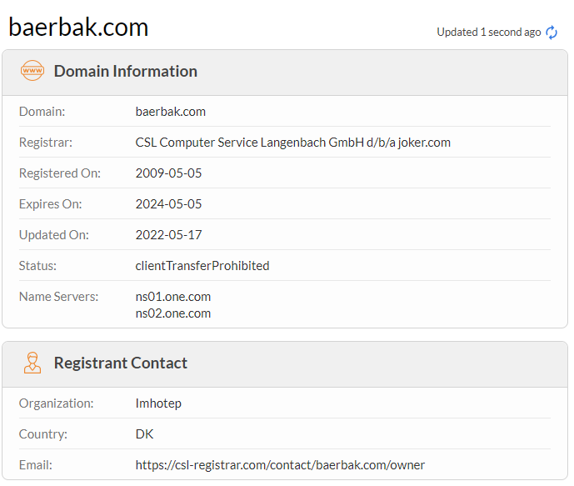
Global DNS
For other domains, you need a ‘registrar’ that handles global registration for you

Slide 24
Name Servers
But you only register the domain, you need a Name Server to handle the actual lookup
My web sites are hosted by one.com, and they provide the name servers
Exercise
Why do you think there are two name servers listed ?

Slide 25
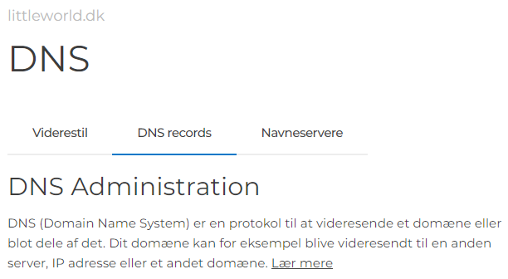
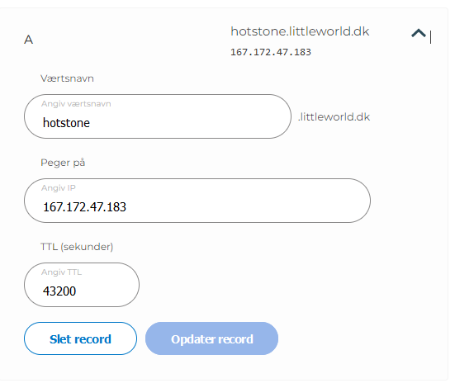
Create a New Name
Scenario: I want to provide a HotStone game server
I do
Rent a virtual machine on DigitalOcean
So I get an IP address of that machine
I log into my ‘one.com’ account, go to the ‘DNS Setting’ pane, and create an ‘A record’ with that IP address

Slide 26
Local DNS
Organizations, like CS, maintain their own local network
And thus needs a DNS for the local machines
Which are ‘visible’ on the local net, but not on the global (=inter)net
One of my machines is m1-dev on st.lab.au.dk network

Slide 27
Resolving Names

Slide 28
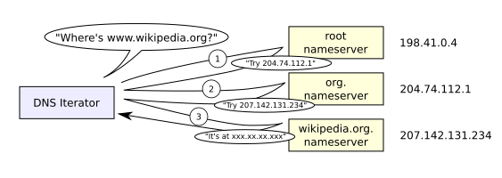
Name Resolution
Any node on the IP network has a (local) Name Server registered, the one to contact first
Windows: ‘nslookup’
Linux: ‘nslookup’ ☺
Algorithm: ”If I do not know, I know who knows”
Picks the name apart right to left!
dk before imhotep before www

Slide 29
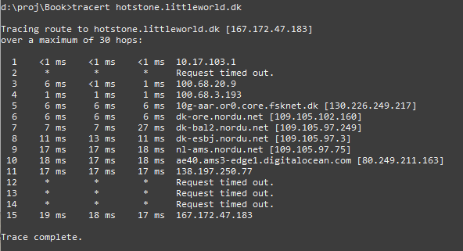
You may trace the lookup path
Windows 10

Slide 30
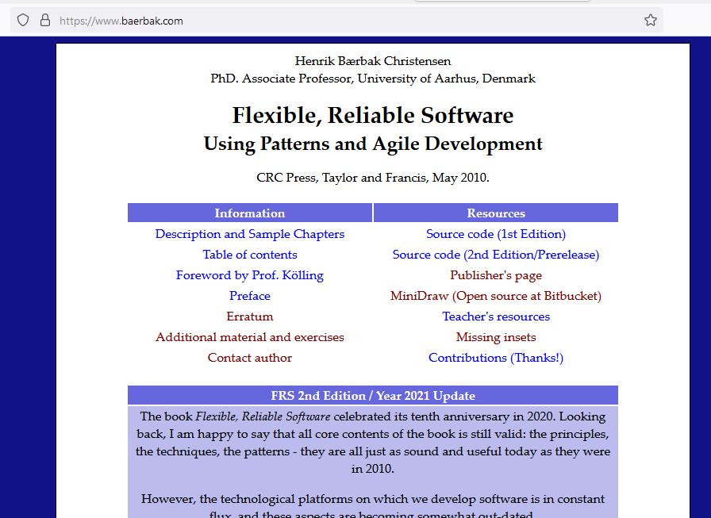
So…
baerbak.com will become
https://www.baerbak.com
Firefox calls DNS server
Translate it into IP address
Firefox will then send a http request to port 80 on that ip address (actually 443 as it is the ‘secure http’ port)
… which will return a HTML document

Slide 31
Or…
I start my ‘quote service’ on a DigitalOcean machine in Amsterdam, on port 6777, assign ‘quote.baerbak.com’ to that IP, and can now get famous quotes in JSON format:
Notes:
Meta: dev@m1e18hbc:~/proj$ docker run -d -p 6777:6777 henrikbaerbak/quote:msdo_1_0_1

Slide 32
Performance
Of course, contacting 3-8 servers just to resolve a DNS entry is extremely expensive
Caching Tactic: ‘Maintain multiple copies of data’
Each DNS server caches the lookup
So my local DNS server knows the address immediately the next time I ask
Browsers maintain their own caches!
No need to talk to the DNS at all after initial domain name has been resolved…

Slide 33
Time To Live
But but – what happens when IPs change then?
All the caches will send requests to the old node?
The principle of delegation is used in DNS
I move my HotStone server to another provider – and get a new IP address
The DNS system has to adapt: TTL: TimeToLive here 12h
Takes up to 24 hours world-wide

Slide 34
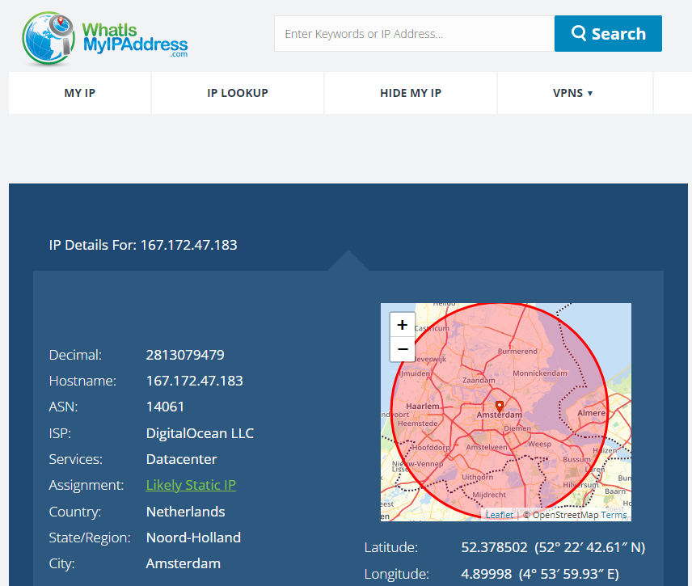
Fun Services
DNS and IP are of course ‘public knowledge’, so there are quite a few fun services to lookup data out there.

Slide 35
Summary
To send a datagram, you have to know the address of the receiver
Every node in an IP network has an IP address
IP address xxx.xxx.xxx.xxx (or IPv6)
Nodes for a wider audience use DNS servers to assign a hostname to a specific IP address
www.dr.dk instead of xxx.xxx.xxx.xxx
Every node has 65.536 ports
Quite a few below 1024 are reserved

Slide 36
TCP
The last piece of the puzzle

Slide 37
Actually, rather hidden
IP splits data into packets/datagrams and sends them
But they get lost!
They become garbled
They arrive out-of-order
TCP introduce reliability
Get packet 1, 2, 3, 5, 7, 6...
Request packet 4 again, and 7 as it was garbled
Forward the full data by putting segments in correct order

Slide 38
Network Address Translation
Weird Behaviour Warning

Slide 39
Segmenting Networks
Organizations, projects, homes create their own LANs.
Security, convenience, performance
Example:
My home router that assigns each connected node an IP in the 192.168.x.x space
But at any time there are thousands of machines with IP 192.168.1.38
How does ‘www.imhotep.dk’ know which computer to return the HTML document to, then???

Slide 40
NAT
So NAT in my router simply change IP:port of the datagrams so the web server returns to the router instead; once it has been received, the router forwards to the local node

Slide 41
Implications
NAT makes networking behave ‘weird’:
I can see you, but you cannot see me!
My home computer can see the full internet, but no computer on the internet can see mine!
They can only see my ISP’s (Internet Service Provider) computer, which is the only one that can see my router, which is the only one who can see my computer!

Slide 42
Implications
VMWare Player does NAT between your host machine and the course VM, Mxx, you are running
It installs additional networks on the host, my Win10 machine
Therefore your host has multiple IP addresses, on multiple networks, used by multiple machines
Meaning host and VM can communicate on the 192.168.*.* network. Remember to use that for local testing!

Slide 43
So, in my VM
Running my VM I can see it is also on the 192.168.*.* network
So they can talk using these IP addresses
Win 10 -> m101
m101 -> Win 10

Slide 44
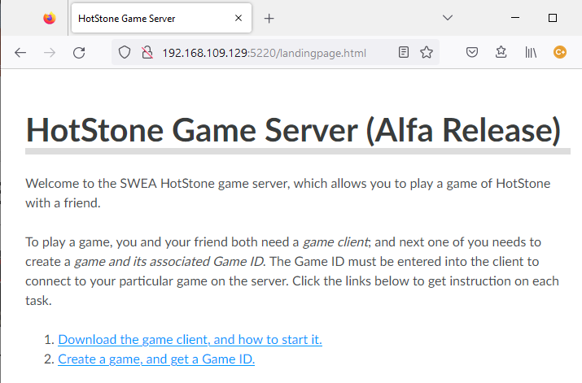
Example
Starting my HotStone server on my m1 VM
Then I can contact it on that IP address from the host:

Slide 45
And…
On EduRoam which most of you are on with your laptops when here at the department…
… things may easily not work!
… because EduRoam maintains firewalls which often deny any communication on non-standard ports
Only on port 80, 443, 22, and some others
And subject to changes all the time!

Slide 46
Handy commands

Slide 47
Some Nice Network Commands
Debug 101
Can my computer see the other computer???
‘ping www.imhotep.dk’
‘ping 192.168.1.37’
What is my IP?
Windows: ipconfig / linux: ifconfig
If not installed, issue
sudo apt install net-tools
to get it ☺

Slide 48
Summary
The Distributed course will go into the more details
I think ☺
Lot of concepts, but not core curriculum in SWEA
However, you will bump into some of these issues in the mandatory project on distribution...
Client and Server need to talk – using their IP addresses and ports…

